Slide 1

#LifeKoKaroLift
Lending Club Case Study - Solution

Slide 2



CaseStudy: EDA - Lending Club Case Study
Name : Shameer Shaik

Slide 3
Contents
Problem Statement
Data Analysis

Slide 4
Problem Statement
Lending Club is a marketplace for personal loans that matches borrowers who are seeking a loan with investors looking to lend money and make a return.
When the company receives a loan application, the company has to make a decision for loan approval based on the applicant’s profile. Two types of risks are associated with the bank’s decision:
If the applicant is likely to repay the loan, then not approving the loan results in a loss of business to the company
If the applicant is not likely to repay the loan, i.e. he/she is likely to default, then approving the loan may lead to a financial loss for the company
The objective of the case study is determine how to reduce the risk in loan approval decision making.
By identifying the markers of applicant who can repay the loan
By identifying the applicants markers who can default the loan

Slide 5
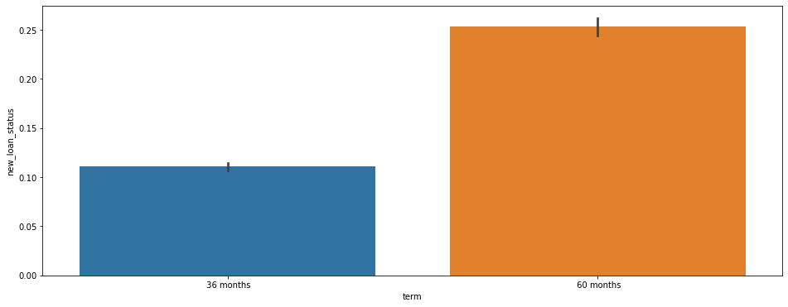
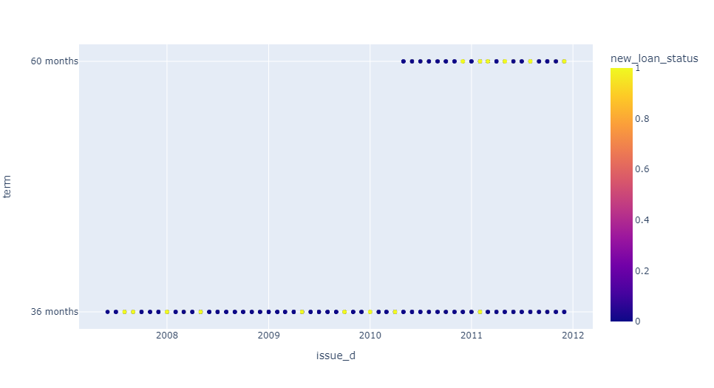
Data Analysis
It is observed that Long term loans are more prone to default
Long term loans started after 2010, number of default seen from 2010 is more in longer term loans (60months)

Slide 6
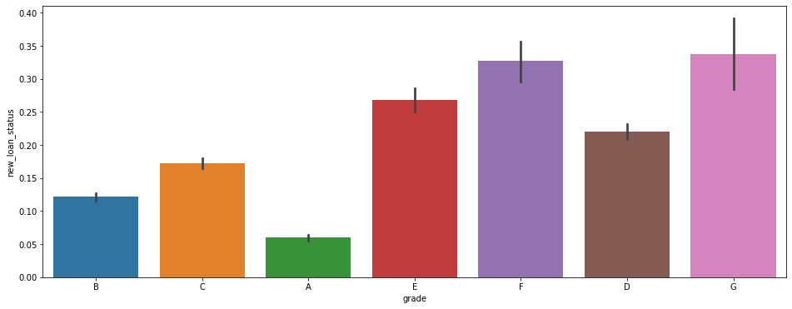
Data Analysis
Default risk is increasing with the Grade.. “G” Grade being the most defaulted grade.

Slide 7
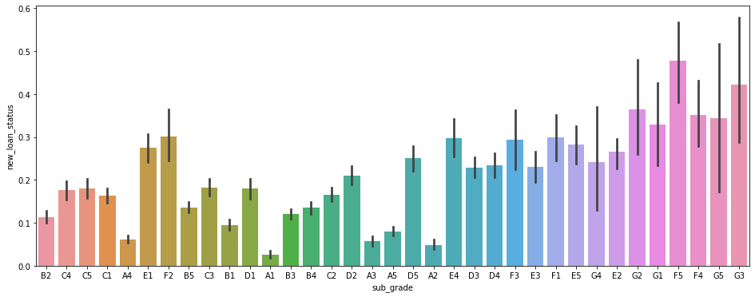
Data Analysis
“F5” and “G3” Sub grades are more defaulted

Slide 8
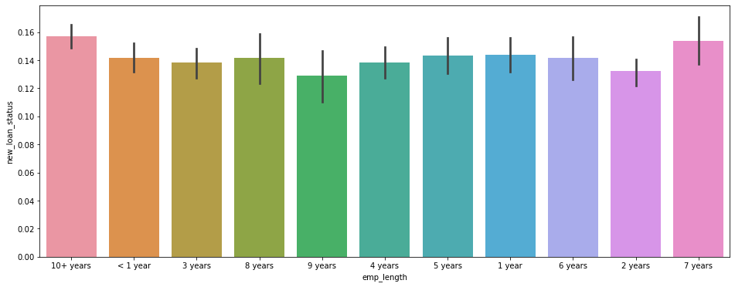
Data Analysis
Employment tenure seems to be no marker for default

Slide 9
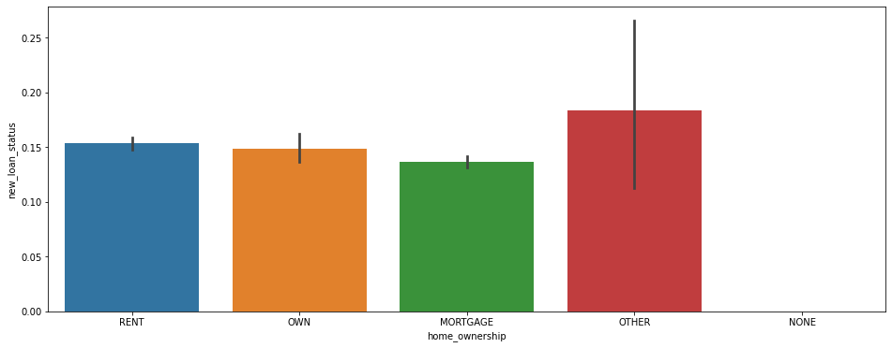
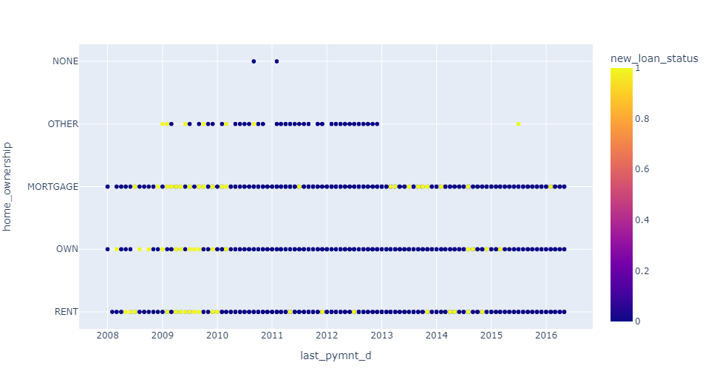
Data Analysis
Mortgage home owners are less prone to default. “Other” need to be analyzed.
However loans with last payment in 2013 to 2014 are having more defaults from Mortgage home owners

Slide 10
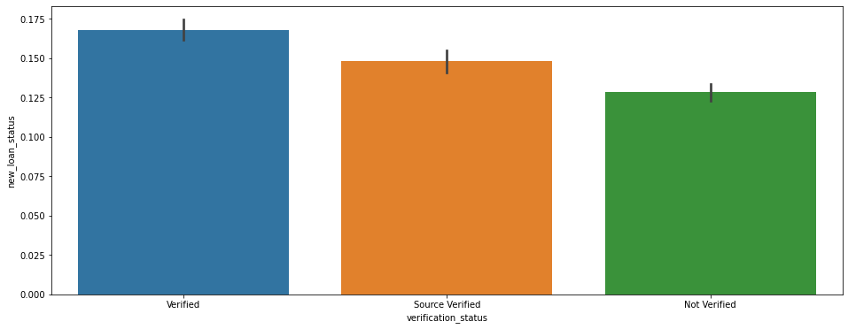
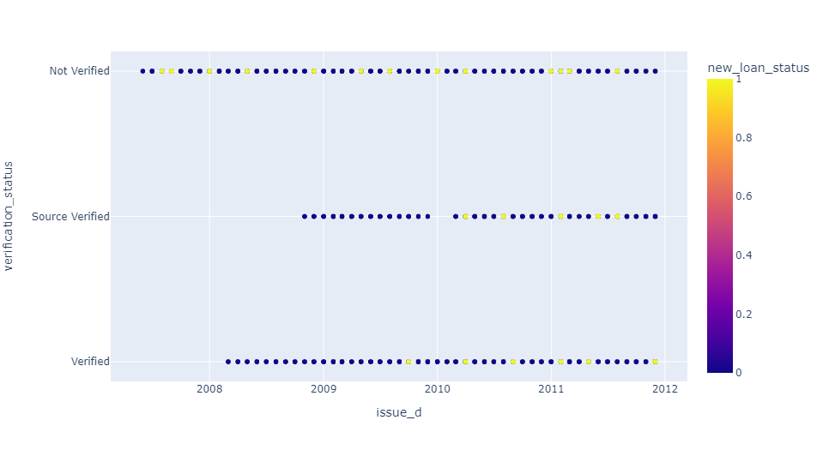
Data Analysis
Verified loans seems to be more default. But this needs to be analyzed with other factors.
It is observed that till Sep 2009 – NO verified loan is Default.

Slide 11
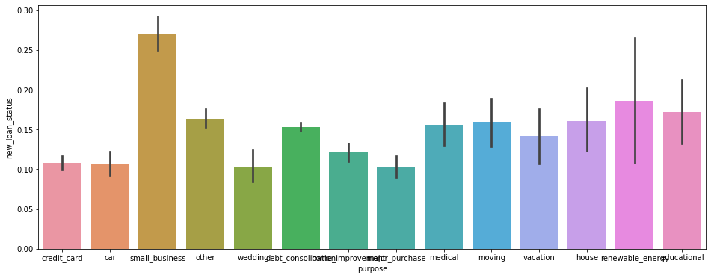
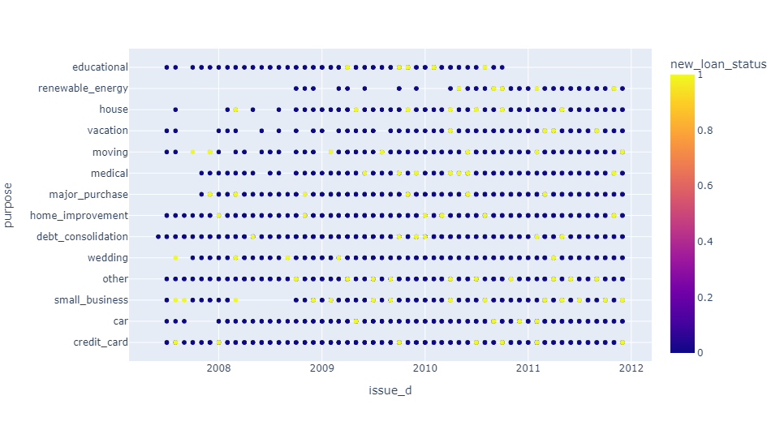
Data Analysis
Small Business prone to more defaults
It is seen consistently over the years Small Business loans are having more defaults

Slide 12
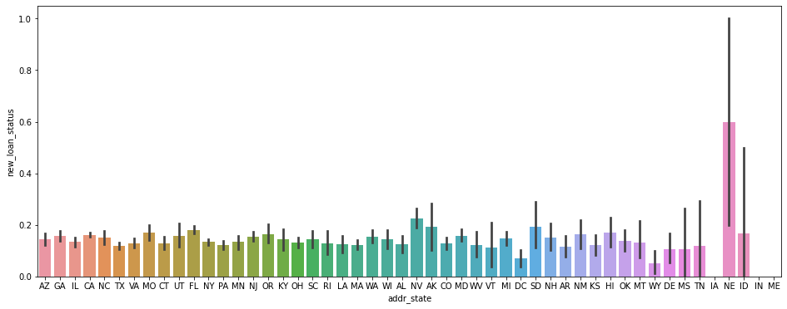
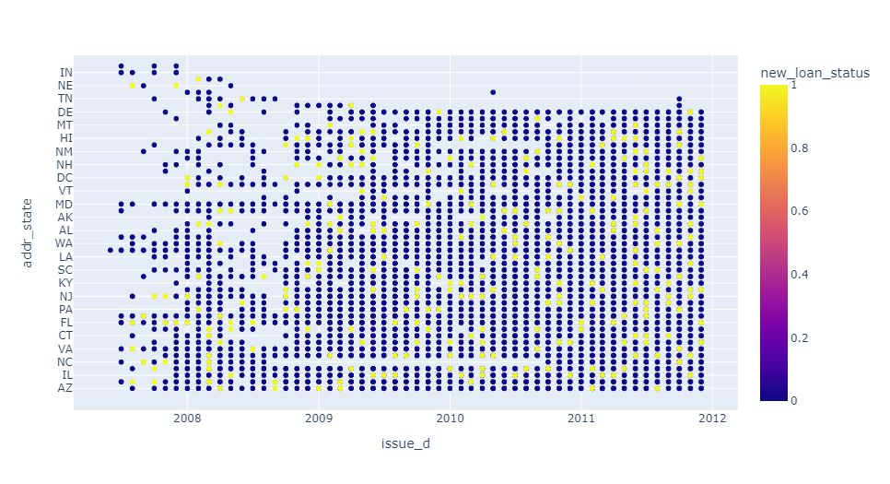
Data Analysis
Nebraska State having more defaults
However it is seen the loans are stopped in NE in 2008

Slide 13
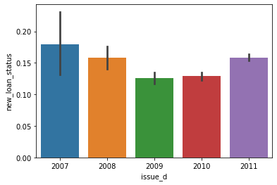
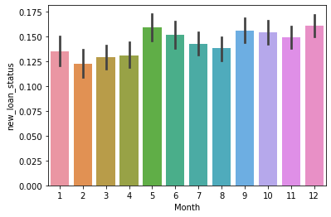
Data Analysis
Defaults have been in down trend till 2009. And again it is seen in increasing trend.
Loan given month is not having influence on Loan default

Slide 14
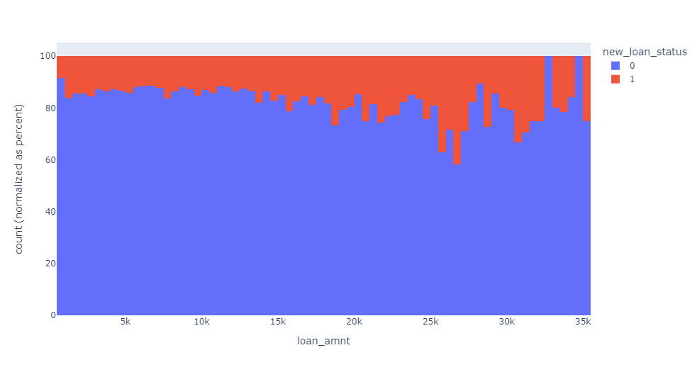
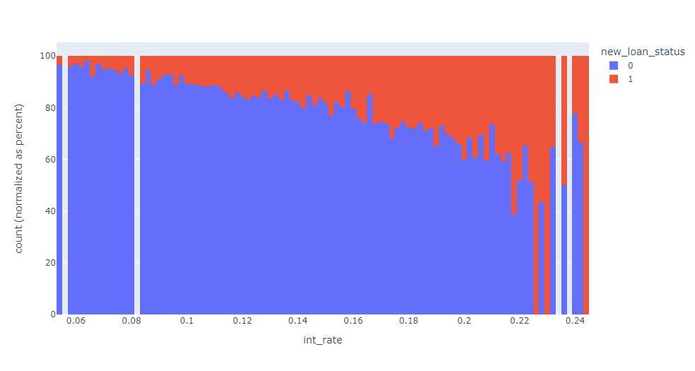
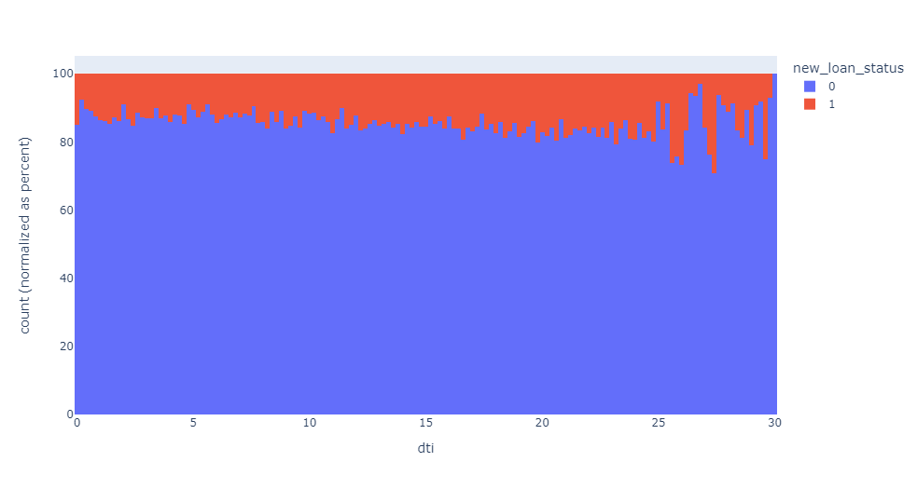
Data Analysis
Close to 42% of the loans are defaulted having loan amount $26K to $27K. Risk is seen increasing with the loan amount
Risk has steep increase with the interest rate increase. Defaults are more than 50% beyond 0.217 rate
DTI beyond 25% is seen risky

Slide 15
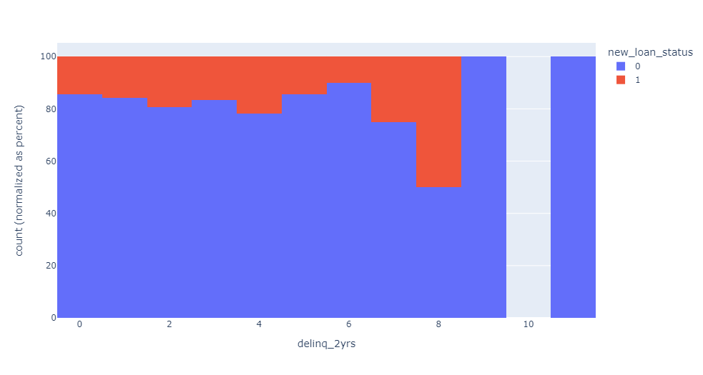
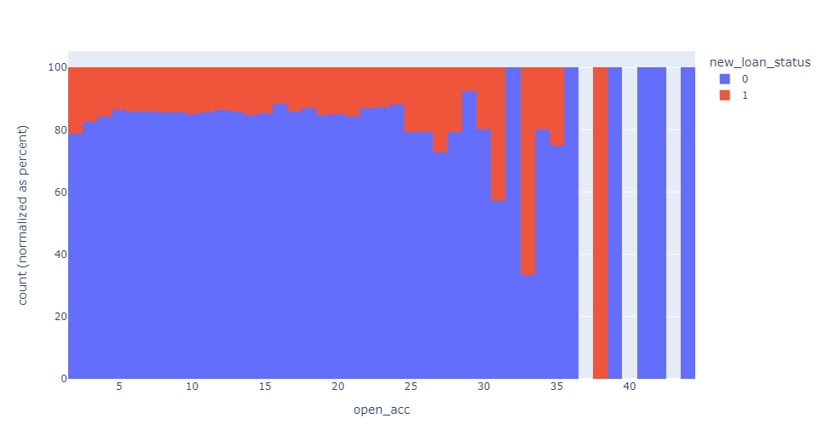
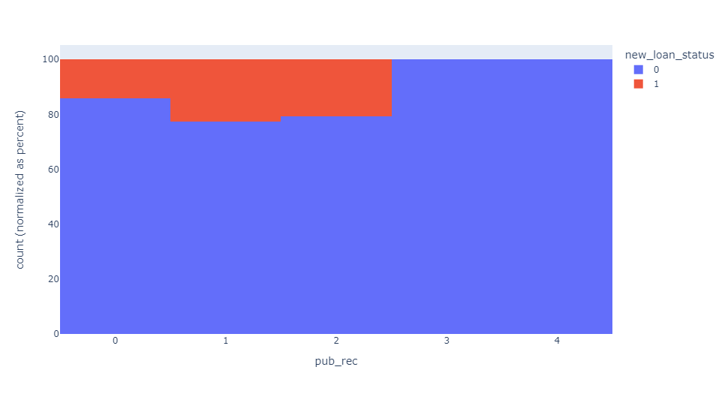
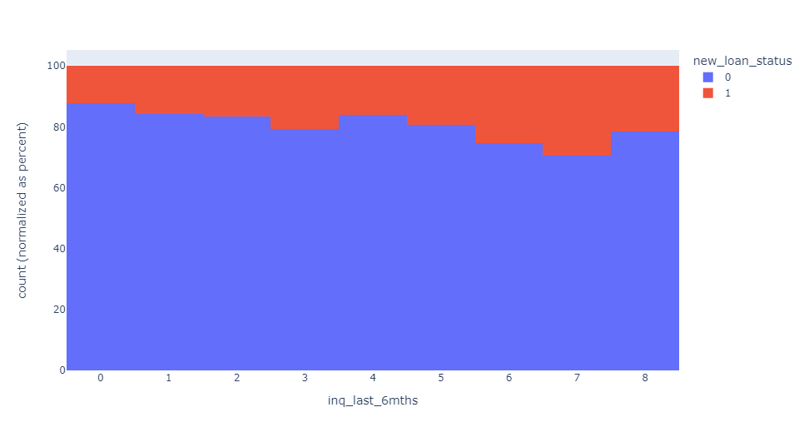
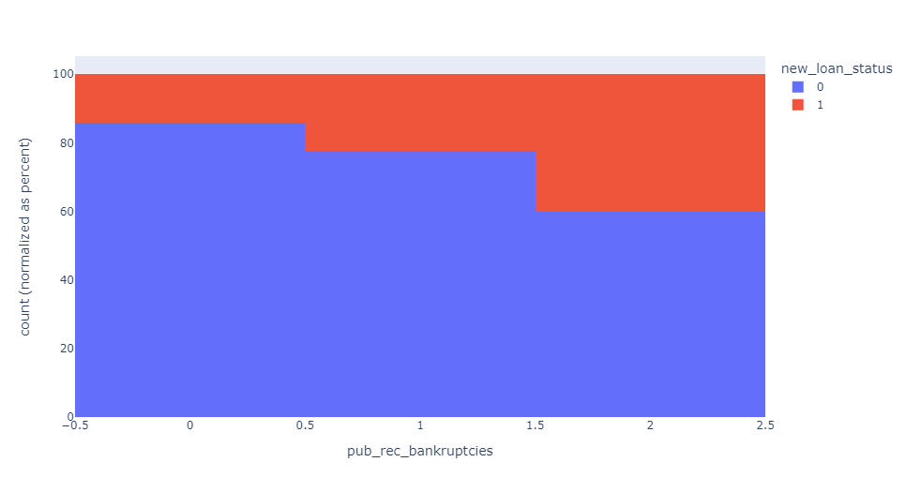
Data Analysis
Risk is increasing with the increase in the below markers –
Number of public record bankruptcies
Number of Delinquency in last 2 years
Number of open credit lines
Number of derogatory public records
Number of inquiries in past 6 months

